Slide 1

Final Capstone Presentation
Diabetic patient readmission prediction
Group 2
Mentor: Vidhya K
Members:
V Keerthi Vikram
Sarvesh Mankar
Kajal Chopda
Nishad Kharwade
Vidhushi Vanjari
Notes:
No Chinese libraries have been used during the making of this project.

Slide 2
Problem Statement
To help the hospital prioritize attention towards certain diabetic patients who have a high probability of getting readmitted to the hospital based on past information from the data collected.

Slide 3
Introduction
Diabetes is a disease that occurs when your blood glucose, also called blood sugar, is too high. There are two types of diabetes Type 1 and Type 2
Type 1 diabetes is a disease in which the body does not make enough insulin to control blood sugar levels. Type 1 diabetes is an autoimmune condition. It happens when your body attacks your pancreas with antibodies.
When you have Type 2 diabetes, your pancreas usually creates some insulin. But either it’s not enough or your body doesn’t use it like it should due to which Insulin resistance, when your cells don’t respond to insulin occurs . It causes health complications, in your kidneys, nerves, and eyes and raises your risk of heart disease and stroke.

Slide 4
Literature Survey
“Diabetes 130-US hospitals dataset” by Weiyan Wu, Yao Jin, Jiwei Wang, Lingyun Mao, Han W.
“Impact of HbA1c Measurement on Hospital Readmission Rates: Analysis of 70,000 Clinical Database Patient Records” By Beata Strack, Jonathan P. DeShazo, Chris Gennings, Juan L. Olmo, Sebastian Ventura, Krzysztof J. Cios and John N. Clore.

Slide 5
Descriptive Statistics
Shape: Rows - 1,01,763 and columns - 50.
Numerical columns - 9 and Categorical columns – 41.
Pre encoded - Admission_type_id, Admission_source_id, Discharge_deposition_id.
There are 24 columns which are drug columns.
By looking at the descriptive statistics and the boxplot it can be said that outliers are present in the dataset.
Target column - ‘readmitted’ – is a categorical column.

Slide 6
Exploratory Data Analysis
Missing values were found in this dataset.
Some columns had above 40% missing values which was dropped.
Missing value imputation was performed via mode.
Statistical significance was done on the predictors with the target.
Some columns were found to be statistically insignificant and dropped.
Few other columns were dropped due to insufficient data based on domain knowledge.

Slide 7
Exploratory Data Analysis
Some numerical columns were combined.
The columns diag_1, diag_2 and diag_3 were further generalized, according to
the ICD-9 2008 codes.
Correlation was checked and it was found that none of the columns are highly correlated with each other.
Multicollinearity was checked and it was found to be absent.
New shape - Rows - 1,01,760 and Columns - 26.

Slide 8
Preprocessing
Skewness was checked for numerical columns.
Transformation was done to reduce skewness.
The numerical columns were scaled to the same scale using Standard Scaler.
Mean Encoding and One-Hot Encoding was performed to encode the categorical variables.
Oversampling (SMOTE) was performed to reduce class imbalance in the dataset in scenarios where applicable.

Slide 9
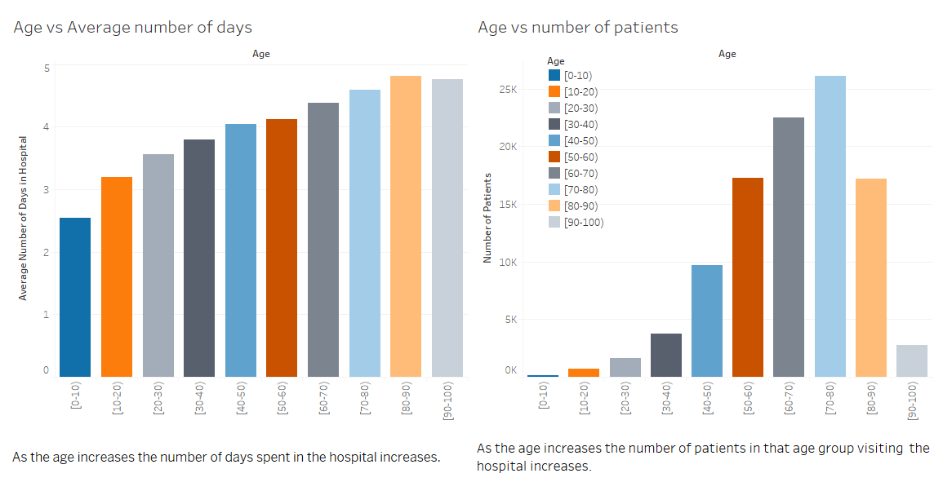

Slide 10
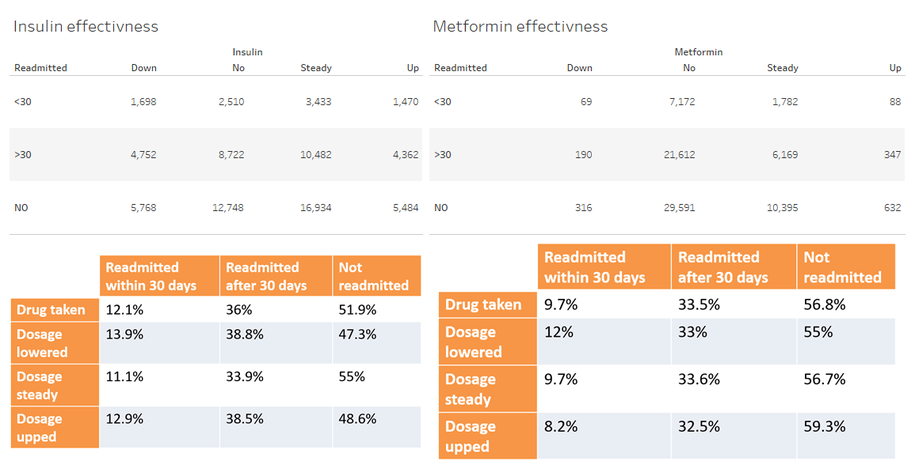

Slide 11
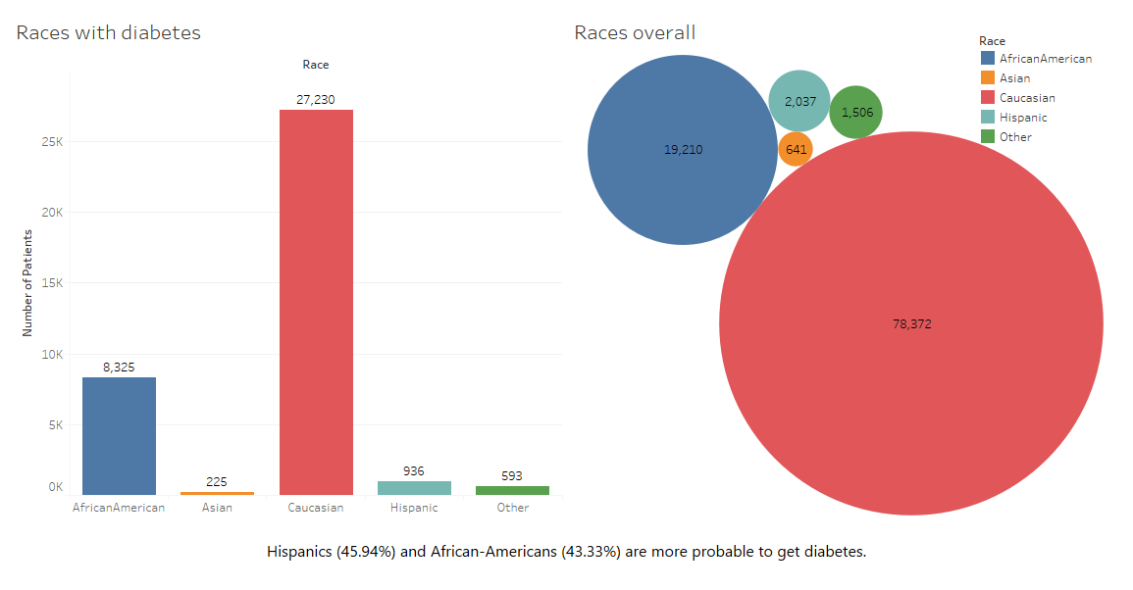

Slide 12
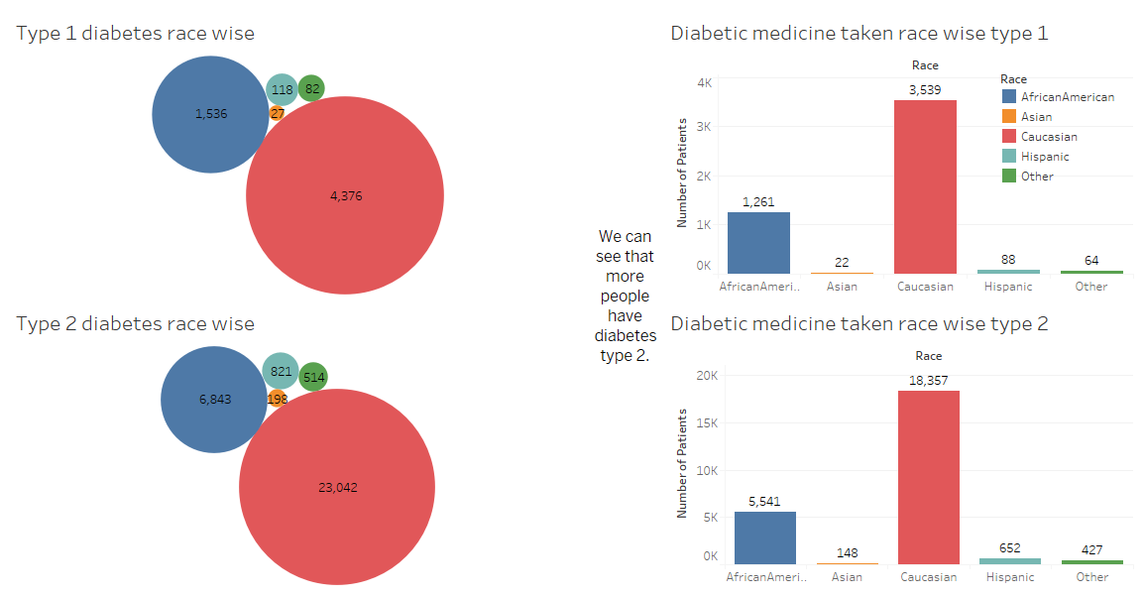

Slide 13
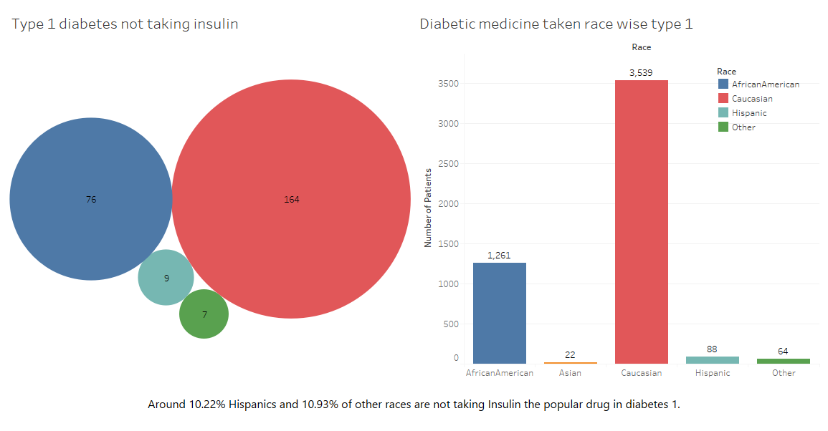

Slide 14
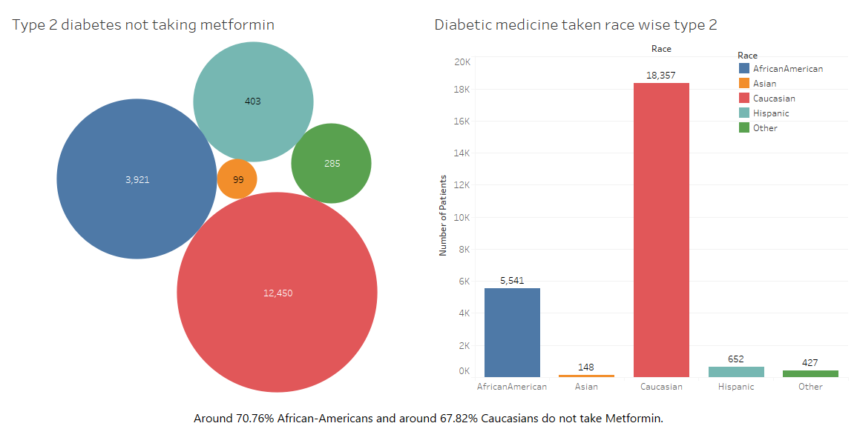

Slide 15
Model Building
We have created 3 scenarios for running the model
Scenario 1- We have 3 sub classes (NO, >30, <30).
Scenario 2 – We have 2 Sub classes (NO, Readmitted).
Scenario 3 – We have 2 sub classes (>30, <30).

Slide 16
Scenario 1
We have 3 subclasses in the target variable.
The subclasses are in the ratio of NO : >30 : <30 is to 53 : 35 : 12.
Oversampling was performed to remove this imbalance.
New shape of the dataset is 1,64,000 rows and 26 columns.
XGBoost has the best accuracy.
Model | Train Accuracy | Test Accuracy
Logistic Regression | 47% | 45%
Decision Tree | 53% | 54%
SVC | 50% | 45%
KNN | 63% | 61%
Random Forest | 69% | 62%
XGBoost | 69% | 64%
Metric | Train | Test
Precision | 0.69 | 0.63
Recall | 0.69 | 0.64
F1-Score | 0.68 | 0.63
Accuracy | 0.69 | 0.64

Slide 17
Scenario 2
We have 2 subclasses in the target variable.
The subclasses are in the ratio of NO : Readmitted is to 54 : 46
LGBMC has the best accuracy.
Model | Train Accuracy | Test Accuracy
Logistic Regression | 64% | 63%
Decision Tree | 65% | 63.5%
SVC | 58% | 56%
KNN | 58% | 56%
Random Forest | 66% | 64%
LGBMC | 64.5% | 67.5%
Metric | Train | Test
Precision | 0.67 | 0.64
Recall | 0.67 | 0.65
F1-Score | 0.67 | 0.64
Accuracy | 0.67 | 0.65

Slide 18
Scenario 3
We have 2 subclasses in the target variable.
The subclasses are in the ratio of >30 : <30 is to 70 : 30.
Oversampling was performed to remove this imbalance.
New shape of the dataset is 71090 rows and 26 columns.
LGBMC has the best accuracy.
Model | Train Accuracy | Test Accuracy
Logistic Regression | 66.7% | 66.5%
Decision Tree | 80% | 74.7%
SVC | 69.7% | 69.4%
KNN | 71.3% | 63.3%
Random Forest | 83% | 84%
LGBMC | 84.2% | 86%
Metric | Train | Test
Precision | 0.89 | 0.87
Recall | 0.86 | 0.84
F1-Score | 0.86 | 0.84
Accuracy | 0.86 | 0.84

Slide 19
Business Inference
The Hospital can use our model in scenario 1 to find out whether they should give higher care to a diabetic patient who might get readmitted in the next 30 days to increase their recovery rate.
The hospital can further use our model in scenario 2 to find out whether a diabetic patient will get readmitted or not to prioritize care.
If the hospital knows a diabetic patient will get readmitted, they can use our model in scenario 3 to find out if the patient will get readmitted before or after 30 days to prioritize care.
A pharmaceutical company producing metformin can focus on marketing it much more as despite being most effective in type 2 diabetes it is not used by a majority of people.

Slide 20
Thank You

